Slide 1


Slide 2


Slide 3

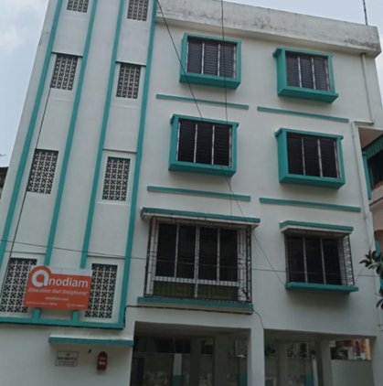


And
© PROTECTED ANODIAM 2023 || PRIVATE & CONFIDENTIAL

Slide 4
Departments
Tech
Commerce
Law
NEET/IIT
VIII to XII Science
Humanities
Professional Courses
Junior Section
Competitive
Co Curricular
© PROTECTED ANODIAM 2023 || PRIVATE & CONFIDENTIAL

Slide 5

Support for Our Faculty
Best talents in the field
Rewarding career growth
Teamwork & synergy
Gratifying environment
Effective marketing support
Feature rich app support
© PROTECTED ANODIAM 2023 || PRIVATE & CONFIDENTIAL

Slide 6
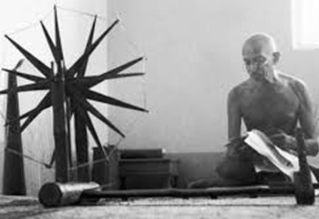
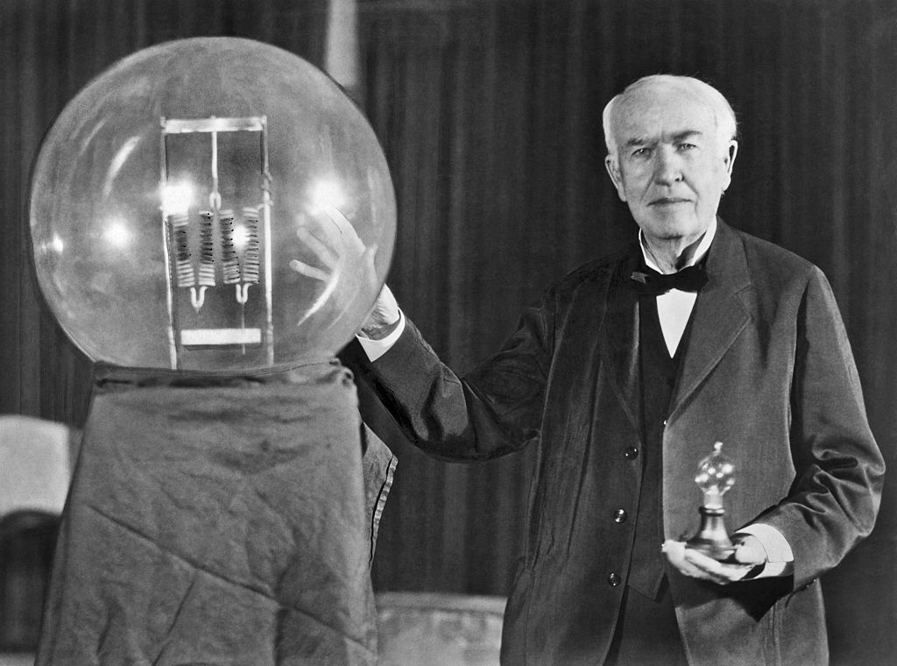
Empathy and Innovation
And
© PROTECTED ANODIAM 2023 || PRIVATE & CONFIDENTIAL

Slide 7
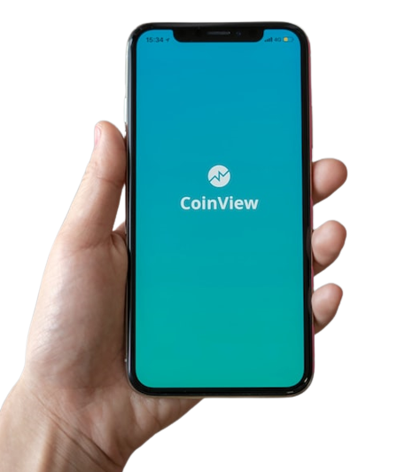

App, Data & the Future
© PROTECTED ANODIAM 2023 || PRIVATE & CONFIDENTIAL

Slide 8
Rules of the Game
Service Quality:
https://drive.google.com/file/d/1G_r3FHIbKvW_MIrk1pjXnWaGsI7cuwu9/view?usp=drive_link
Duty of Care:
https://drive.google.com/file/d/1hfySZSaXL6i4bUkUEeti6EmXvrap2TSS/view?usp=drive_link
General Norms:
https://drive.google.com/file/d/1py8g-mL1CZNGLnQhjhyVZzBF_Oci3IG3/view?usp=drive_link
Contract Renewal & Termination: https://drive.google.com/file/d/1zDsPqdytCvrsidFRuwlRwIOcDfiSvVhz/view?usp=drive_link
Holidays and Leaves:
https://drive.google.com/file/d/15fp6MCw9pUoM4jJ6p09Xdi6DMpdGX6Ky/view?usp=drive_link
Privacy & Security:
https://drive.google.com/file/d/1E236lx8Rxe3Rk1MN-Fz1MyyRX-9S3YQj/view?usp=drive_link
© PROTECTED ANODIAM 2023 || PRIVATE & CONFIDENTIAL

Slide 9

Marketing
Welcome!
© PROTECTED ANODIAM 2023 || PRIVATE & CONFIDENTIAL

